Slide 1


Slide 2
Computer Vision
The goal of computer vision is to make useful decisions about real physical objects and scenes based on sensed images.
Images and movies are everywhere
Fast-growing collection of useful applications
  building representations of the 3D world from pictures
  automated surveillance (who’s doing what)
  movie post-processing
  face finding
Various deep and attractive scientific mysteries
  how does object recognition work?
Greater understanding of human vision

Slide 3
Need & Importance
Autonomous Robots
Industry
Character Recognition
Finding images in large collections
  searching for pictures
  browsing collections of pictures
  Find me the picture of Jinnah
Surveillance
  Warn me if there is some movement in the area
HCI
  Do what I show you
Military
  Shoot this, not that

Slide 4
Why study computer vision?
Vision is useful
Vision is interesting
Vision is difficult
  Half of primate cerebral cortex is devoted to visual processing
  Achieving human-level visual perception is probably “AI-complete”

Slide 5
Connections to other disciplines
Artificial Intelligence
Robotics
Machine Learning
Computer Vision
Computer Graphics
Psychology
Neuroscience
Image Processing

Slide 6
Steps of computer vision
Computer mimics human sight in four steps
  Image acquisition
  Image Processing
  Image Analysis
  Image understanding / Comprehension

Slide 7
Image Acquisition
It translate visual information into a format that can be further manipulated by the brain
Computer vision system needs an eye

Slide 8
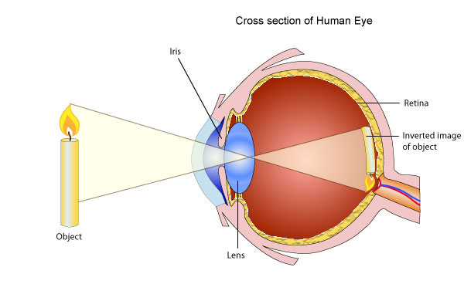
Human Vision System

Slide 9
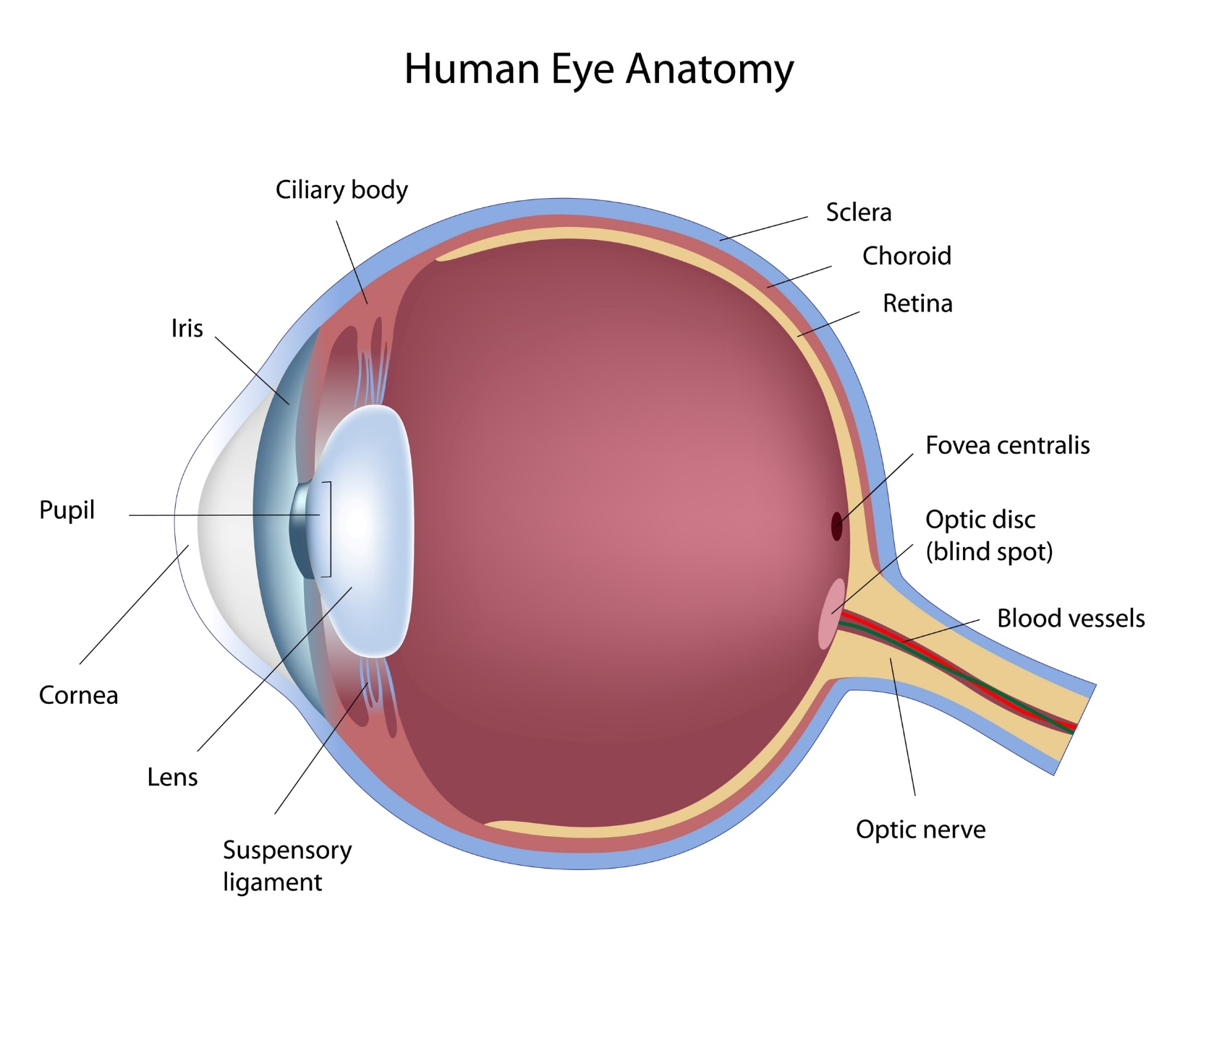

Slide 10
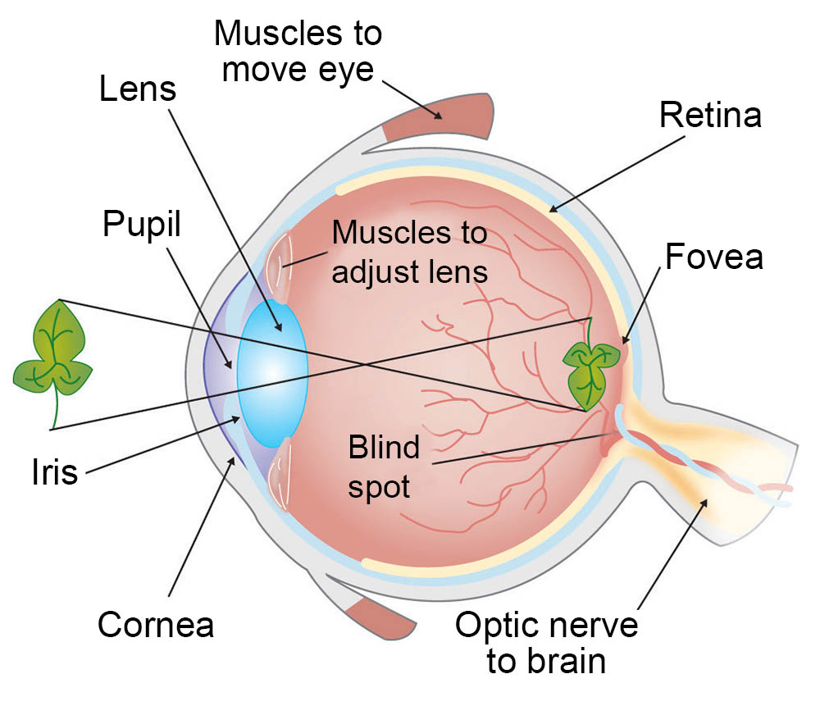

Slide 11
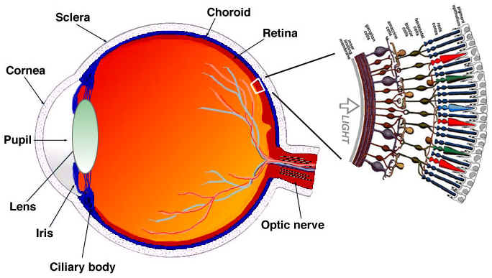
Rods and Cones

Slide 12
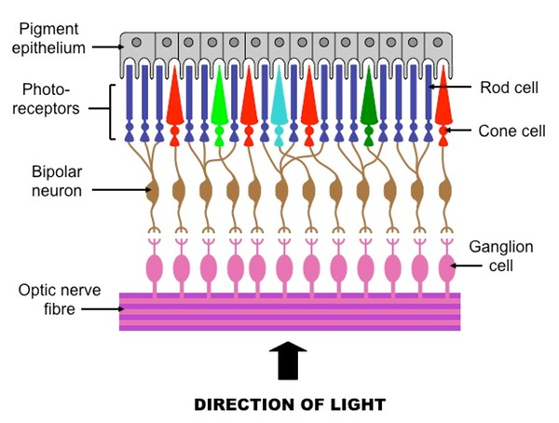
Rods and Cones

Slide 13

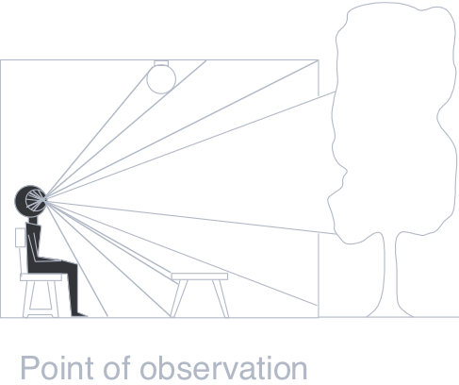
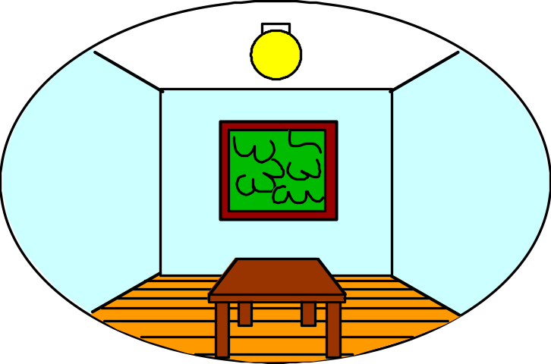
3D world
2D image
What have we lost?
  Angles
  Distances (lengths)
Slide by A. Efros
Figures © Stephen E. Palmer, 2002

Slide 14
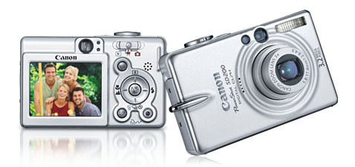

Digital camera
    Used for image acquisition

Slide 15
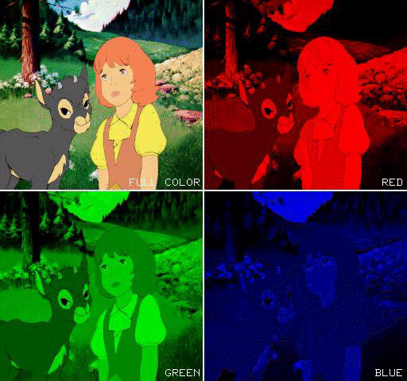
Red, Green, and Blue are used to Create a Color Image

Slide 16
Steps of computer vision
Computer mimics human sight in four steps
  Image acquisition
  Image Processing
  Image Analysis
  Image understanding / Comprehension
With binary version of the scene stored in memory, image processing can now begin
It is also known as image enhancement
It’s the process of improving the quality of the image
Anything that can be done to make the image clearer will simplify analysis and lead to improved understanding

Slide 17
Image processing
Initial manipulation of the binary data take place
  Helps to improve the quality of the image for analysis and comprehending
  Improve the signal-to-noise ratio
  Contrast in scenes can be improved
  Unwanted reflections can be removed

Slide 18
Image processing
Optical filtering is used in which filters are used with the lenses to control the amount of light, its color and the contrast of the various objects in the scene
Controlling illumination level
Positioning of objects to light for increasing the visibility
Steps involved are:
  Noise reduction
  Gray scale modification-lighten or darken the scene
  Histogram flattening

Slide 19
Steps of computer vision
Computer mimics human sight in four steps
  Image acquisition
  Image Processing
  Image Analysis
  Image understanding / Comprehension

Slide 20
Image Analysis (1 of 3)
Up to this point, the scene is described
It can be an outdoor landscape, an aerial photograph, a human face or a toy
Image analysis begins the process of locating and defining the various objects in the scene.
Image analysis is accomplished by identifying regions and boundaries or edges.
Edges represent boundaries where two surfaces come together

Slide 21
Image Analysis (2 of 3)
It can also identify the interface between two different surfaces or between an object and a background
An edge is also formed between two objects when one is in front or back of another
The first step in image analysis is to locate all of these edges and boundaries
The line between an object and its shadow, and the outline of the shadow itself form edges

Slide 22
Image Analysis (3 of 3)
Edges and regions or surfaces completely define the scene
Regions are large, flat areas of an object or scene that have the same intensity value and occur between various edges and boundary lines

Slide 23
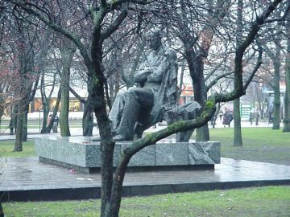
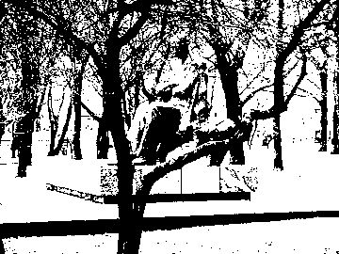
First step is create a binary image based on some cut off value for pixel intensity.

Slide 24
Steps of computer vision
Computer mimics human sight in four steps
  Image acquisition
  Image Processing
  Image Analysis
  Image understanding / Comprehension

Slide 25
  Image or understanding deals with manipulation of digital images through a digital computer.
  It is a subfield of signals and systems but focus particularly on images.
  The input of that system is a digital image and the system process that image using efficient algorithms, and gives an image as an output.
  The most common example biometric sytem

Slide 26
Summary
CV tries to provide a computer an ability to see and understand.
Videos and images can be treated same as videos are also images with certain frame rate.
Firstly, an image must be acquired and digitalized-Image Acquisition
Secondly, an image must be processed to remove any irregularities and noise.
Then, an image must be analyzed to detect edge and boundaries-Image Analysis
Lastly, an image is understood by template matching-Image Comprehension

